Slide 1

GLOBAL SHARK ATTACKS
Predicting shark fatalities using conventional and text based methods

Slide 2

DATA WRANGLING
The data obtained from Global shark attack database was not very clean and required some wrangling
The missing values were interpolated using traditional statistic methods
Age was interpolated with the mean of all ages
Some columns like time had to be dropped since imputing them was not possible

Slide 3
INFERENTIAL STATISTICS Chi square test for independence was used to gain more insight about the data. The following results were obtained
There is a relationship between fatality and activity
There was no relationship between gender and fatality

Slide 4
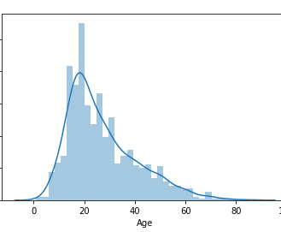
Data visualization and Analysis Age Analysis
There is just a hint of positive skew in the age distribution
The mean of ages is 27.08
The mean of fatal and non- fatal ages don’t differ that much
Non-Fatal = 26.9
Fatal = 27.5

Slide 5
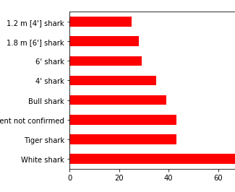
SPECIES
Species column was very messy and only a little analysis could be done
The White Shark species did the most attacks it is the largest of all predatory sharks

Slide 6
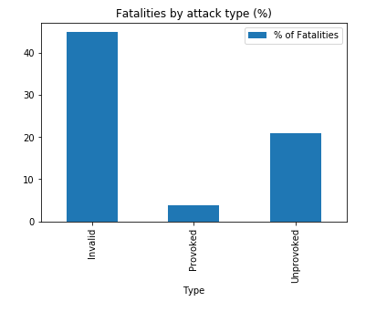
PROVOCATION TO FATALITY
Now clearly provocation does not lead to deaths
The only activity which is very provocative is fishing
Unprovoked cases are mostly due to mistaken identity

Slide 7
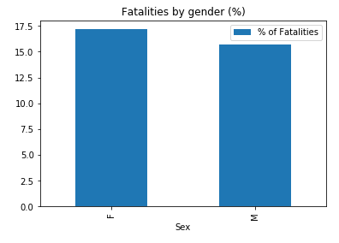
GENDER VS FATALITY
Strangely females have more fatalities then male
There is no definitive theory behind this it is just a co-incidence

Slide 8
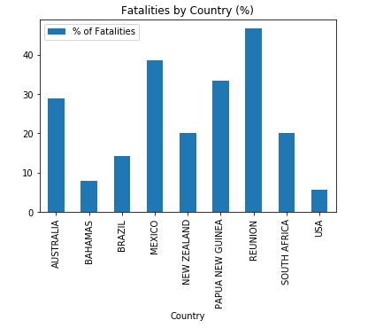
Countries with most fatalities
Reunion islands have a large fatality rate followed by Mexico and papua new guinea
REUNION HAS ONLY ABOUT 15 ATTACKS AND ALMOST 50 PERCENT OF THEM ARE FATAL
AMONG COUNTRIES WITH A LARGER COASTLINE AUSTRALIA STAND OUT FOLLOWED BY BRAZIL

Slide 9
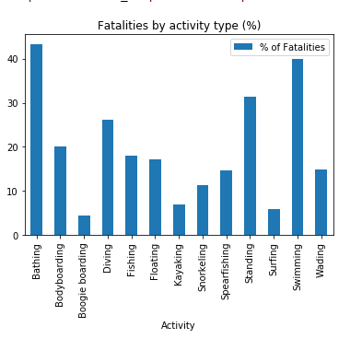
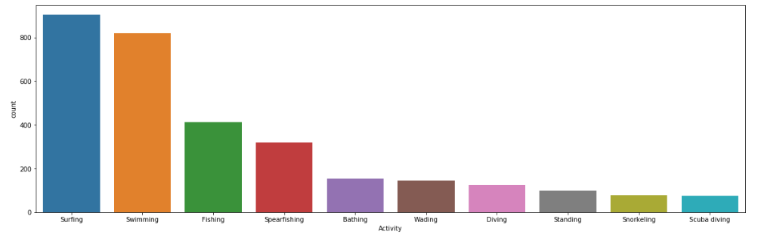
ACTIVITIES
Despite surfing having the most number of attacks the fatalities are highest for swimming and bathing.

Slide 10
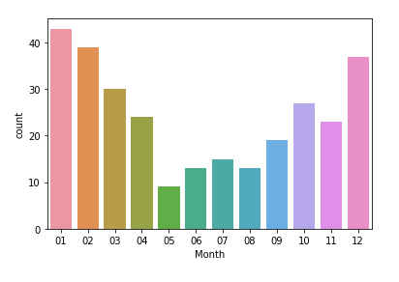
ATTACKS DISTRIBUTION BY MONTH
This is for Australia
It is very evidently clear that all of the attacks take place in December,January and February
This is the height of summer in Australia

Slide 11
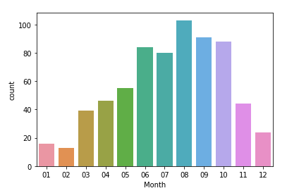
ATTACKS IN US The pattern is same in US

Slide 12
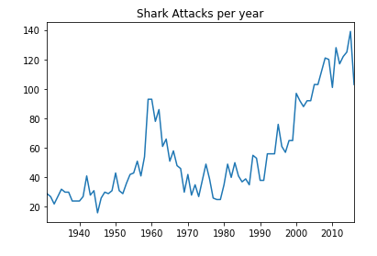
SHARK ATTACKS BY YEAR

Slide 13
FEATURE ENGINEERING AND ML

Slide 14
TRAINING DATA
All feature Engineering was done to come up with final training data
Only two attack types are taken by replacing boat,sea disaster to unprovoked
Type,Sex,Age,Month and Activity are considered for Input features
All the categorical features are one-hot encoded to arrive at final dataset

Slide 15
MODELS USED
Logistic Regression,Decision Tree,Random Forest,Ada Boost and XG-Boost
Now since we are dealing with Imbalanced class we use SMOTE(Synthetic minority over sampling technique) and the metric we use the F1-Score
XG-Boost gives best F1-Score but we avoid using that for such simple data
Logistic Regression and Random Forest are the best models

Slide 16
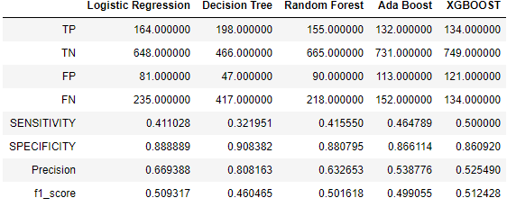
MODELS
This table gives the performance metrics for all models

Slide 17
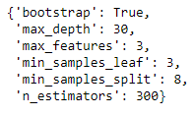
Hyperparameter tuning
The tuning did not give good results

Slide 18
USING TEXT COLUMN FOR PREDICTIONS

Slide 19
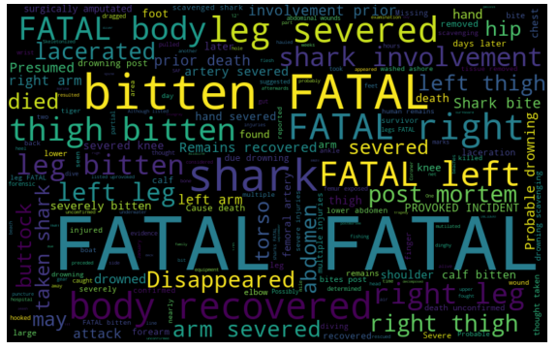
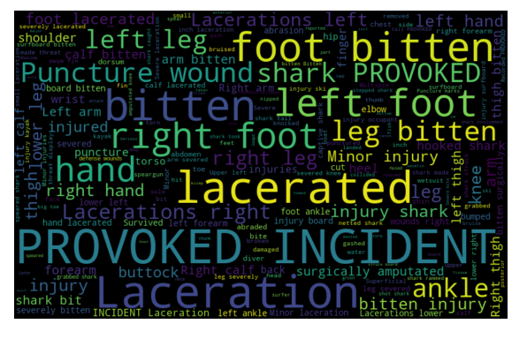
Word clouds for non-fatal and fatal attacks

Slide 20
Multinomial Naïve bayes
This model gives an F1-Score of 0.98
Hence we can say that predicting fatalities with just the injury column gives better results then conventional techniques

Slide 21
CONCLUSION
To summarize the following steps were performed to arrive at the final result:
Data Wrangling
Inferential Statistics
Exploratory Data Analysis
Feature Engineering
Machine Learning

